Slide 1

Report Writing
Data Analysis Guide

Slide 2
What You Need
In order to analyse a set of data we first need;
A complete set of tables for both the results and their uncertainties
A Graph showing the key information from the experiment – Use the “Representing Data with Excel” resource on Moodle to help you
A table containing the trendline values and their uncertainties – Use the “How to Find the Uncertainty in Trendline Values”

Slide 3
What You Need
A complete set of tables for both the results and their uncertainties

Slide 4
What You Need
A Graph showing the key information from the experiment

Slide 5
What You Need
A table containing the trendline values and their uncertainties

Slide 6
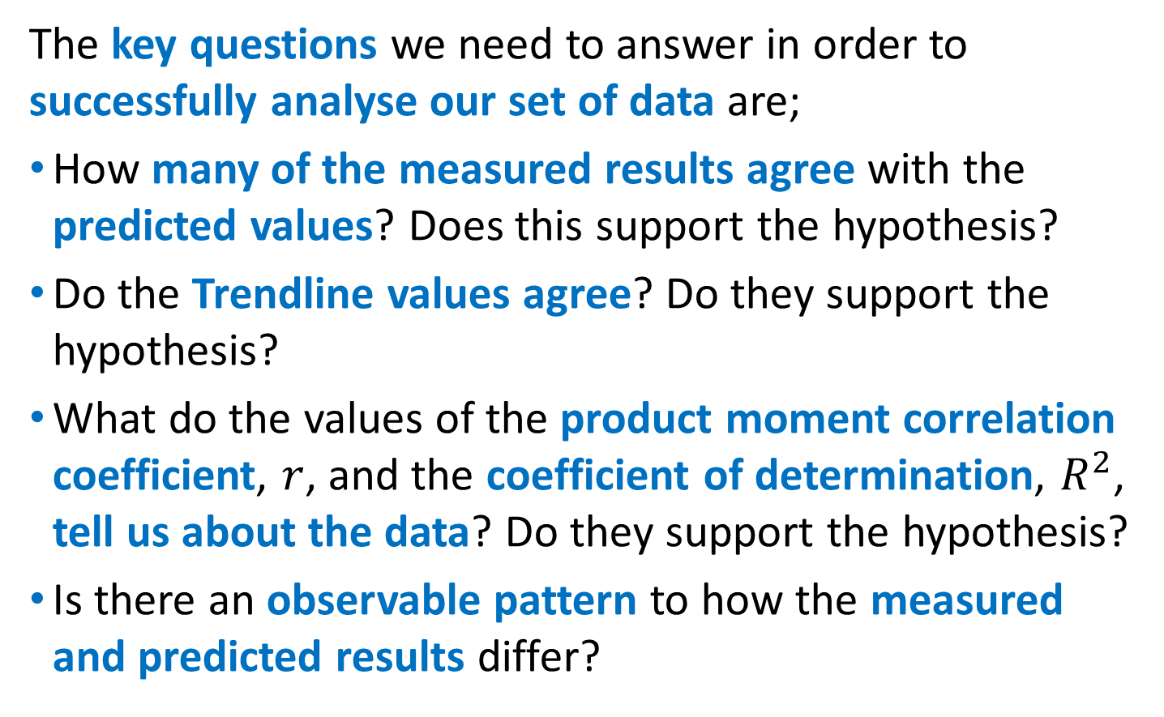
Analysing Data
The key questions we need to answer in order to successfully analyse our set of data are;
How many of the measured results agree with the predicted values? Does this support the hypothesis?
Do the Trendline values agree? Do they support the hypothesis?
What do the values of the product moment correlation coefficient, $r$, and the coefficient of determination, $R^{2}$, tell us about the data? Do they support the hypothesis?
Is there an observable pattern to how the measured and predicted results differ?

Slide 7
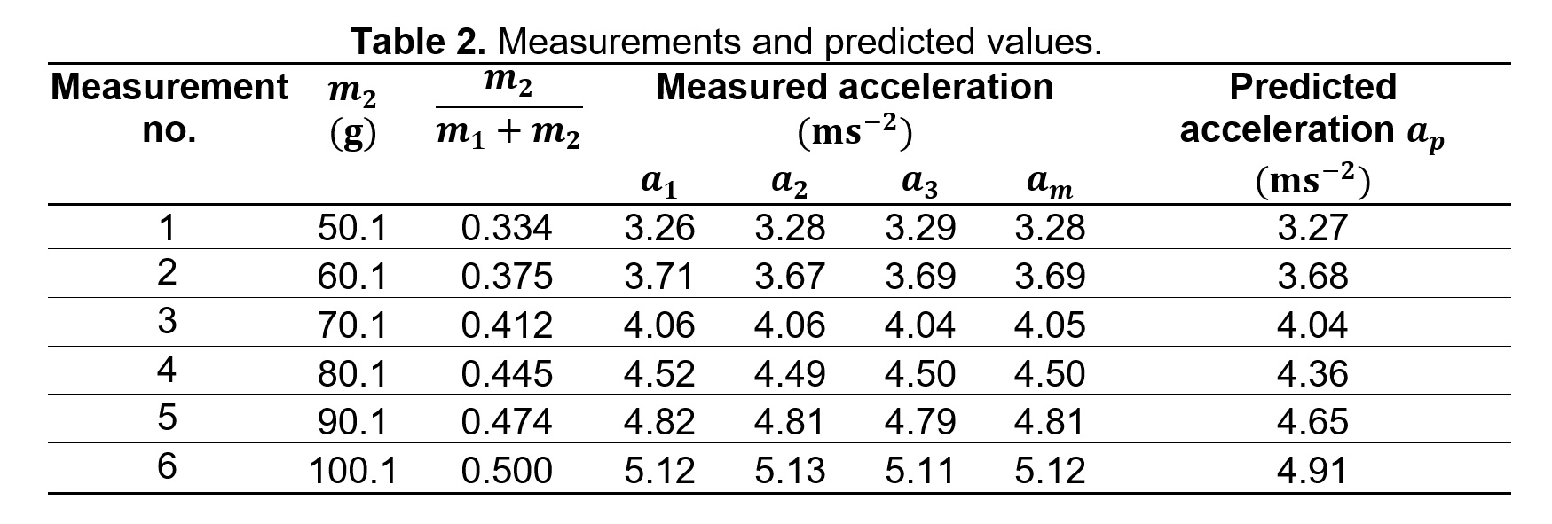
Comparing Measured & Predicted Results
You may have noticed that the measured and predicted values in the table are not the same, does this mean that the results do not support the hypothesis?
How do we decide how close the predicted and measured results need to be?

Slide 8
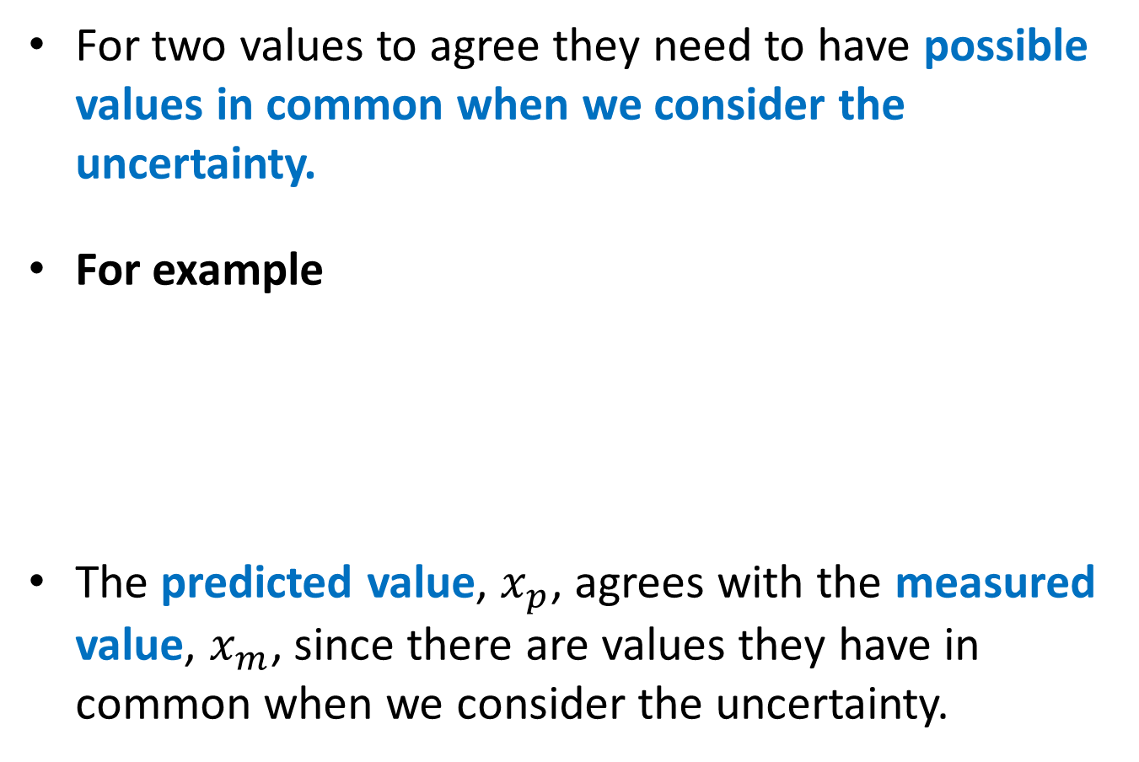




Comparing Measured & Predicted Results
For two values to agree they need to have possible values in common when we consider the uncertainty.
For example
The predicted value, $x_{p}$, agrees with the measured value, $x_{m}$, since there are values they have in common when we consider the uncertainty.
Value
Uncertainty
$$x_{m}=20.8±0.2$$
$$x_{p}=20.7±0.4$$
$$20.6≤x_{m}≤21.0$$
$$20.3≤x_{p}≤21.1$$

Slide 9
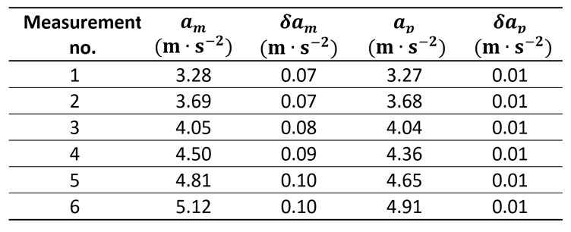


Comparing Measured & Predicted Results
One way to make the comparison easier is to make a new table containing the measured and predicted values and their uncertainties.
So 3 out of 6 of the measured values agree with the predicted values.

Slide 10
Comparing Measured & Predicted Results
We can instead use the Graph to compare the values. If the uncertainty error bars overlap, then the results agree.

Slide 11

Comparing Measured & Predicted Results
To support a hypothesis we need the majority (more than half) of the measured values to agree with the predicted values.
Since only half of the results agree with the predicted values there is not enough evidence to support the hypothesis.

Slide 12
Comparing Trendline Values
Just like comparing the measured and predicted values in the table, we should use the uncertainty to decide if the trendline values agree or not.
Clearly the measured values are not within uncertainty range of the predicted values.
This evidence does not support the hypothesis.

Slide 13
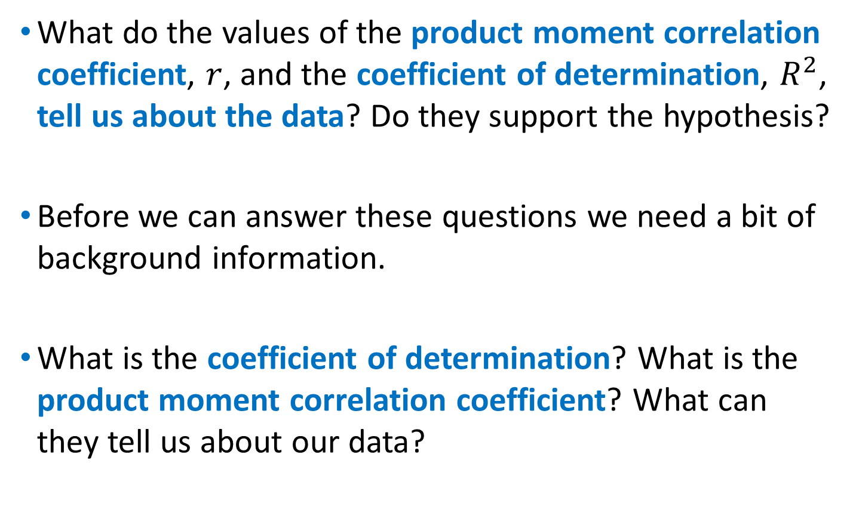
Correlation Coefficients
What do the values of the product moment correlation coefficient, $r$, and the coefficient of determination, $R^{2}$, tell us about the data? Do they support the hypothesis?
Before we can answer these questions we need a bit of background information.
What is the coefficient of determination? What is the product moment correlation coefficient? What can they tell us about our data?

Slide 14
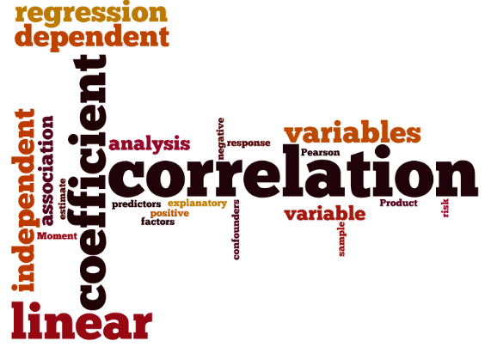


Coefficient of Determination
The coefficient of determination, ${R }^{2}$, varies between
$${0≤ R }^{2}≤1$$
For a linear trendline line, the value of ${R }^{2}$ is related to the product moment correlation coefficient by the following formulae;
$${R }^{2}=r^{2}$$

Slide 15
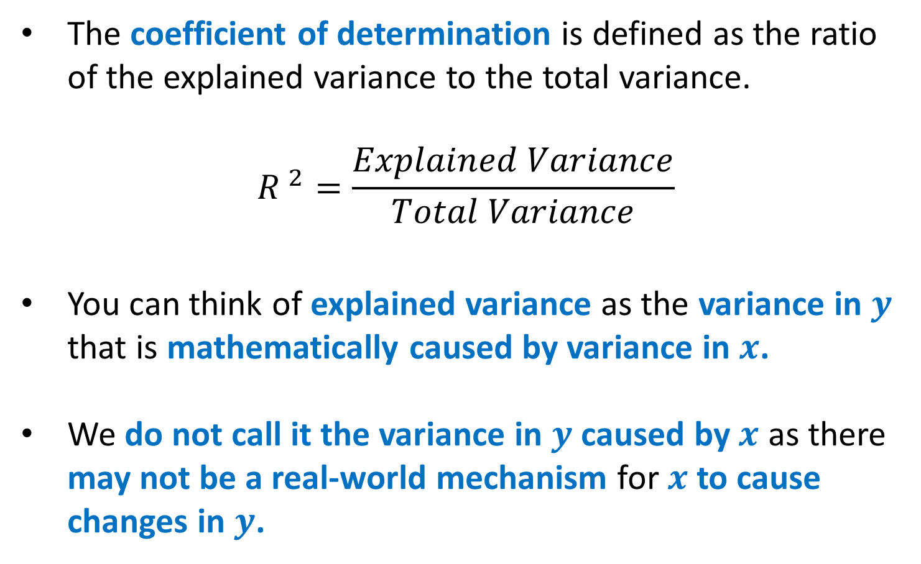
Coefficient of Determination
The coefficient of determination is defined as the ratio of the explained variance to the total variance.
$${R }^{2}=\frac{Explained Variance}{Total Variance}$$
You can think of explained variance as the variance in $y$ that is mathematically caused by variance in $x$.
We do not call it the variance in $y$ caused by $x$ as there may not be a real-world mechanism for $x$ to cause changes in $y$.

Slide 16

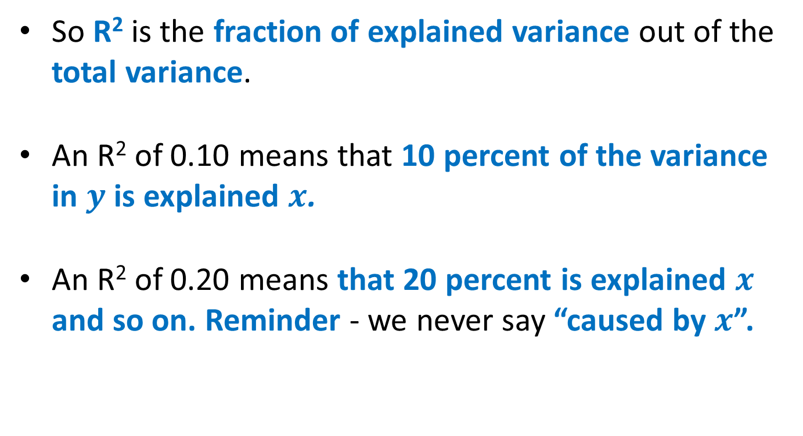
Coefficient of Determination
So R² is the fraction of explained variance out of the total variance.
An R² of 0.10 means that 10 percent of the variance in $y$ is explained $x$.
An R² of 0.20 means that 20 percent is explained $x$ and so on. Reminder - we never say “caused by $x$”.

Slide 17
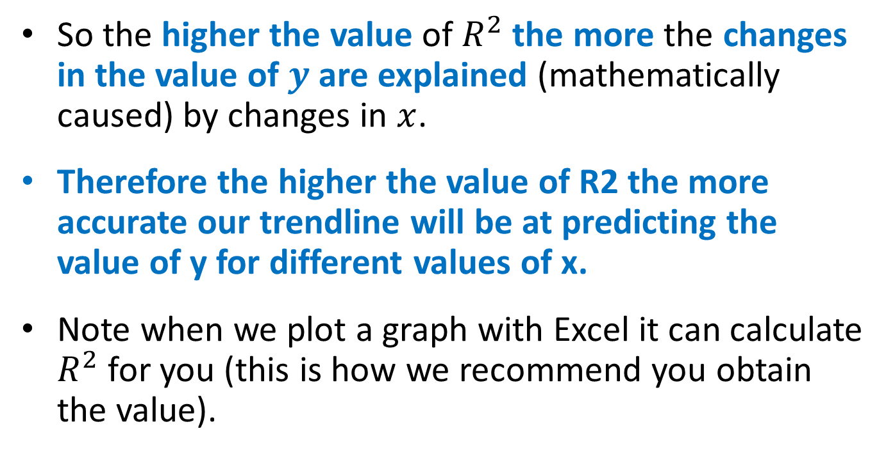
Coefficient of Determination
So the higher the value of $R^{2}$ the more the changes in the value of $y$ are explained (mathematically caused) by changes in $x$.
Therefore the higher the value of R2 the more accurate our trendline will be at predicting the value of y for different values of x.
Note when we plot a graph with Excel it can calculate $R^{2}$ for you (this is how we recommend you obtain the value).

Slide 18

Product Moment Correlation Coefficient
The product moment correlation coefficient, r, varies between
Variable 1 (y)
$$−1≤r≤1$$
Variable 2 (x)
If r = 1, this indicates a perfect positive correlation (all points lie on the line of best fit, and it has a positive gradient).
If r = -1, this indicates a perfect negative correlation (all points lie on the line of best fit, and it has a negative gradient).

Slide 19
Type of Correlation
The type of the correlation is determined by how y changes as x changes.
Variable 1
None
Variable 2
Positive
Negative
Variable 1
Variable 1
Variable 2
Variable 2

Slide 20
Strength of Correlation
The strength of the correlation is determined by how close the points are to the trendline.
Strong Positive
Weak Positive
Strong negative
Weak negative

Slide 21
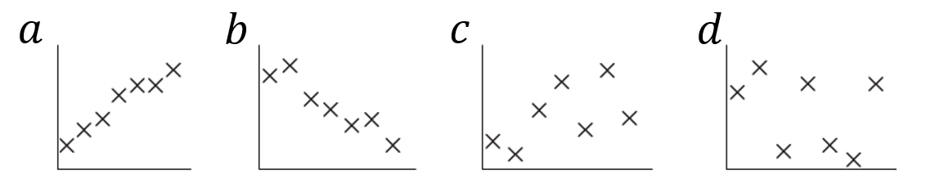
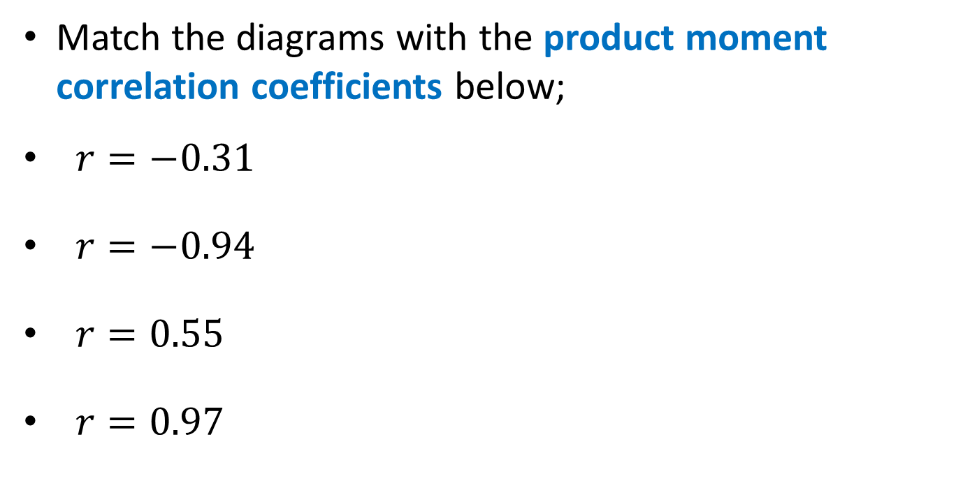




Product Moment Correlation Coefficient
Match the diagrams with the product moment correlation coefficients below;
$r=−0.31$
$r=−0.94$
$r=0.55$
$r=0.97$
$$d$$
$$b$$
$$c$$
$$a$$

Slide 22


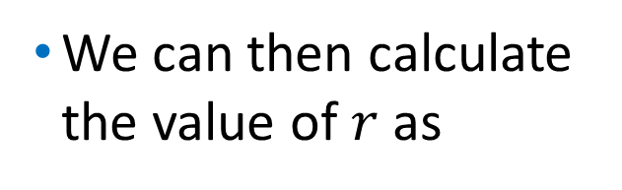
Correlation Coefficients
What do the values of the product moment correlation coefficient, $r$, and the coefficient of determination, $R^{2}$, tell us about the data? Do they support the hypothesis?
So we can obtain the value of $R^{2}$ from the graph.
We can then calculate the value of $r$ as
$$r=\sqrt{R^{2}}$$

Slide 23
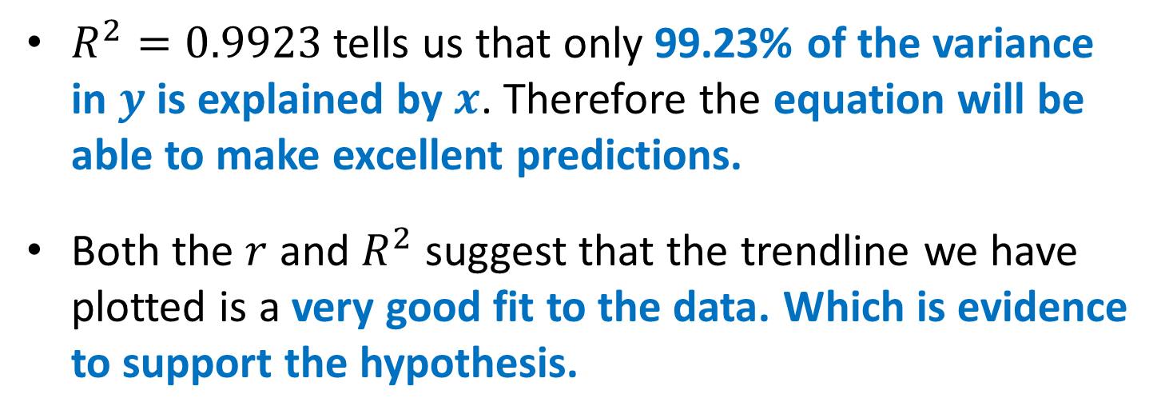

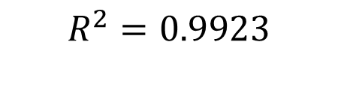

Correlation Coefficients
$$R^{2}=0.9923$$
$$r=\sqrt{R^{2}}=0.9964$$
$r=0.9964$ tells us that the data has a very strong positive correlation.
$R^{2}=0.9923$ tells us that only 99.23% of the variance in $y$ is explained by $x$. Therefore the equation will be able to make excellent predictions.
Both the $r$ and $R^{2}$ suggest that the trendline we have plotted is a very good fit to the data. Which is evidence to support the hypothesis.

Slide 24
Finding a Pattern in the Data
The graph is usually the best way to spot any patterns or relationships for the data points that do not agree with the predicted values

Slide 25
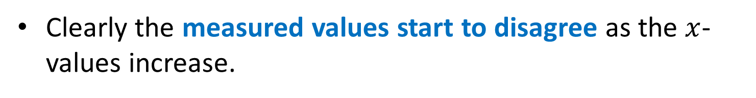
Finding a Pattern in the Data
Clearly the measured values start to disagree as the $x$-values increase.

Slide 26

Finding a Pattern in the Data
In fact as $x$ increases the difference between the measured and predicted values gets bigger.

Slide 27

Overview
Overall, the results do not support the hypothesis since the majority of the measured values, the gradient of the trendline and the intercept of the trendline all disagree with the predicted values.
The values of coefficient of determination and product moment correlation coefficient both suggest that a straight-line relationship is an excellent fit to the data, however this is not enough evidence on its own.

